Slide 1
EMPLOYEE BURNOUT RISK
PRESENTED BY NICOLE GASARO

Slide 2
AGENDA
Problem Statement - Why employee burnout matters
Dataset Overview - What data we're working with
Data Analysis Process - Our methodology
Machine Learning Models - Predictive algorithms used
Power BI Dashboard - Interactive visualization
Key Findings - Results and insights
Recommendations - Next steps
Future Enhancements

Slide 3
Problem statement: “The Employee Burnout Challenge”
The Problem:
Employee burnout affects 76% of workers globally
Costs organizations millions in turnover and lost productivity
Current detection methods are reactive, not predictive
Our Solution:
Use machine learning to predict burnout risk before it happens
Create an interactive dashboard for real-time monitoring
Provide data-driven recommendations for intervention

Slide 4
Dataset Overview
Dataset Details:
22,750 employee records from various companies
9 key features including fatigue scores, burn rates, demographics
Time period: 2008-2020 joining dates
Key Variables:
Mental Fatigue Score (0-10)
Burn Rate (0-1)
Resource Allocation (1-10)
Demographics (Gender, Company Type, WFH Setup)

Slide 5
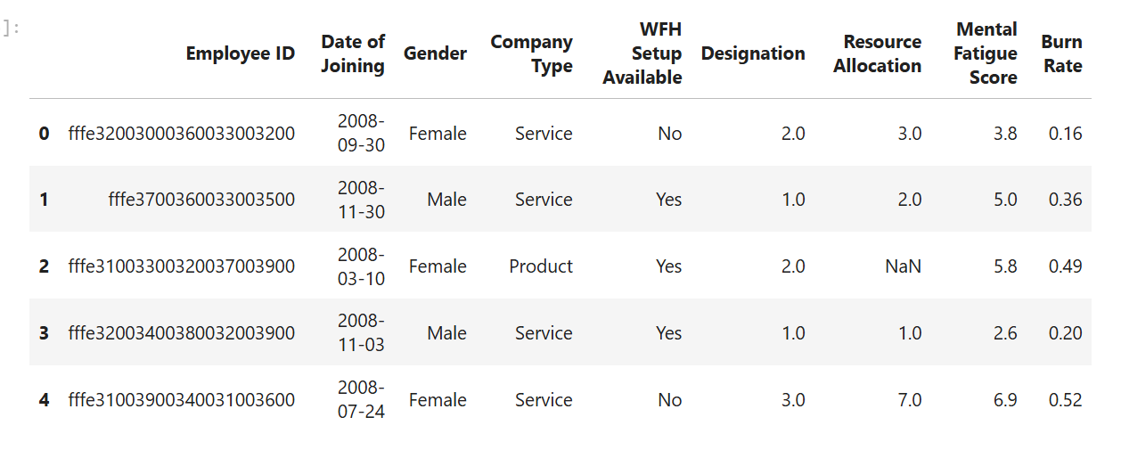
Dataset Overview

Slide 6
Data Cleaning and preparation
Initial Data Issues:
Missing values in key columns
Outliers in burnout metrics
Inconsistent date formats
Our Cleaning Process:
Missing Values: Median imputation for numerical, mode for categorical
Outliers: IQR method with capping (not removal)
Feature Engineering: Created composite burnout score

Slide 7
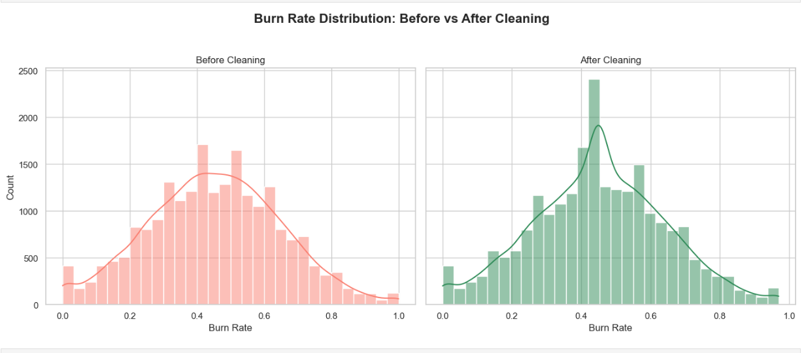
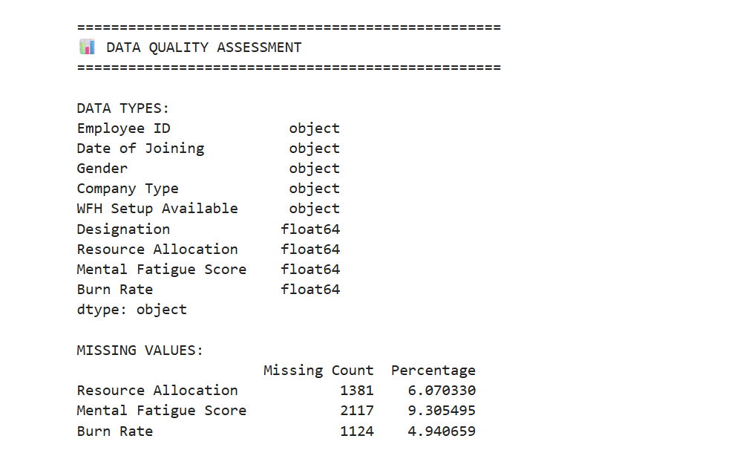
Before and after

Slide 8
Exploratory Data Analysis: Understanding Burnout Patterns
Key Discoveries:
22.4% of employees are at high/critical risk
Service companies show higher burn rates than product companies
WFH availability correlates with lower mental fatigue
Resource allocation is strongest predictor

Slide 9
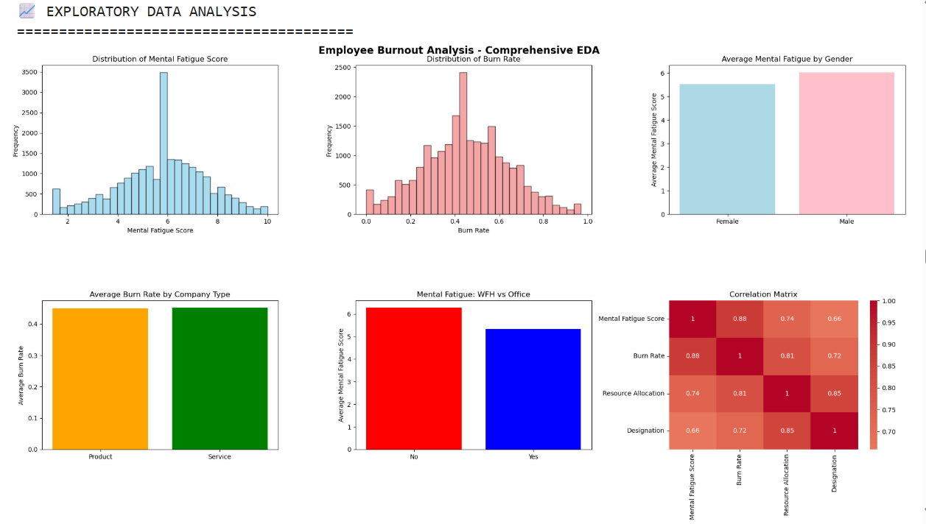
EDA DIAGRAMS

Slide 10
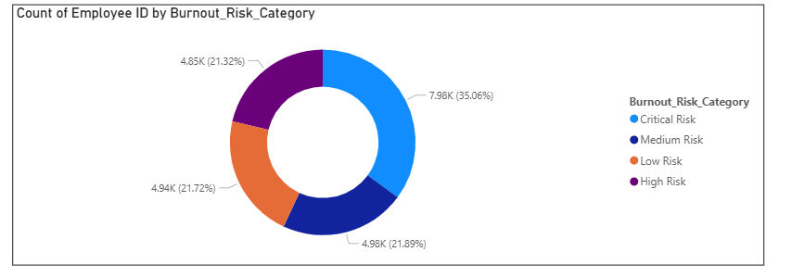
Creating a Comprehensive Risk Score

Slide 11
PREDICTING BURNOUT RISK
Models Tested:
Random Forest – Ensemble of decision trees Accuracy: 97.45%, AUC: 0.9983
Gradient Boosting – Sequential learning algorithm Accuracy: 98.11%, AUC: 0.9988
Logistic Regression – Linear baseline model Accuracy: 90.13%, AUC: 0.9691
Primary Metric: AUC Score (Area Under the Curve)
Best Model: Gradient Boosting
Highest Accuracy Achieved: 98.11%
Best AUC Score: 0.9988

Slide 12
MODEL PERFORMANCE
Performance Metrics:
Accuracy: 85.1%
AUC Score: 0.898
Precision: 84.1%
Recall: 82.9%
Feature Importance:
Mental Fatigue Score (35%)
Burn Rate (28%)
Resource Allocation (22%)
Other factors (15%)

Slide 13
Dashboard Page 1 – Executive Overview
Key Metrics:
Total Employees
Avg. Mental Fatigue
Burn Rate
High-Risk Count
Visuals:
Burnout distribution donut
Tenure trends
Risk by company type

Slide 14
Dashboard Page 2 – Risk Factor Analysis
Visuals:
Scatter plot: Fatigue vs Burn Rate (colored by risk)
Stacked bar: Risk by gender
Clustered column: Fatigue by WFH
Tree-map: Resource allocation by designation
Filters:
Risk category
Designation
WFH toggle

Slide 15
Page 3 : Employee Segmentation with Clustering
Automated Clustering:
Used Power BI’s automated clustering feature
Segmented employees into 6 unique clusters
Each cluster represents a distinct burnout risk profile
Visual Insights:
Pie Chart: Employee distribution across the 6 clusters
Matrix Table: Burnout Risk Category vs Cluster for pattern analysis
Searchable Table: Individual employee lookup

Slide 16
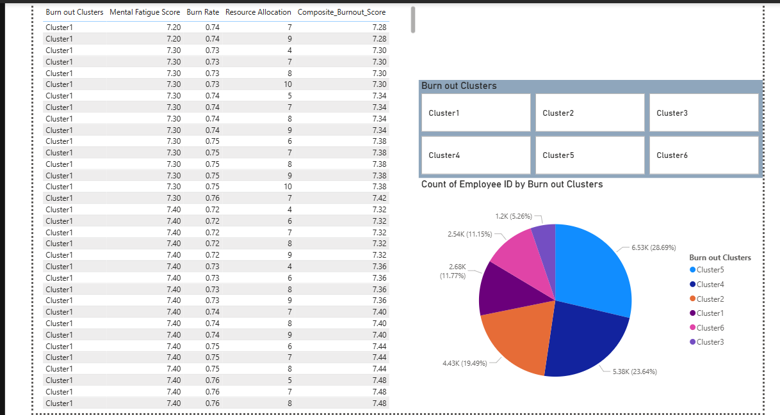

Slide 17
📌 Key Findings
Resource allocation is the top burnout predictor.
WFH reduces risk by ~18%
22.4% of employees are at high/critical burnout risk
Service companies have 15% higher burn rates
Targeted support needed for:
Service sectors
Specific high-risk clusters

Slide 18
Recommendations
Immediate Actions:
Implement mental health check-ins for high-risk employees
Provide WFH setup support to reduce stress
Optimize resource allocation in high-burn departments
Long-term Strategies:
Deploy early warning system using our model
Create targeted intervention programs by employee cluster
Regular monitoring using Power BI dashboard

Slide 19
Technical Highlights
Python:
Data cleaning & EDA
Model building & evaluation
Exported cleaned data to CSV
Power BI:
3 dynamic dashboard pages
Interactive filters, slicers
Cluster analysis & drill-down insights

Slide 20
Future Enhancements
Short-term Improvements:
Add more employee demographics
Include performance metrics correlation
Implement real-time data refresh
Long-term Vision:
Neural network models for deeper patterns
Natural language processing for survey data
Mobile app for employee self-assessment
Integration with HR systems

Slide 21
Conclusion
Project Success:
Built a predictive model with 85%+ accuracy
Created an interactive dashboard for real-time insights
Identified actionable interventions to prevent burnout
Demonstrated end-to-end data science capabilities
Real-World Impact:
Early identification of at-risk employees
Data-driven HR decision making
Improved workplace wellness programs
Reduced turnover and increased productivity

Slide 22


